Slide 1
CASE STUDY – JAVA APPLICATIONS SECURITY HARDENING
Carnegie Mellon Software Engineering Institute
https://wiki.sei.cmu.edu/confluence/display/java/SEI+CERT+Oracle+Coding+Standard+for+Java

Slide 2
CASE STUDY – JAVA APPLICATIONS SECURITY HARDENING
1. Identify critical assets (& asset owner)
2. Research on applicable security controls
3. Checklist of applicable controls
5. Implement controls on test setup
4. Document controls into SOP
6. Validation of control implementation
7. Change management process for PROD
8. Implement on PROD & monitor

Slide 3
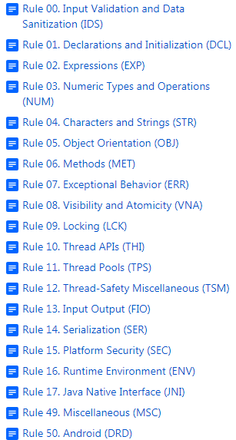
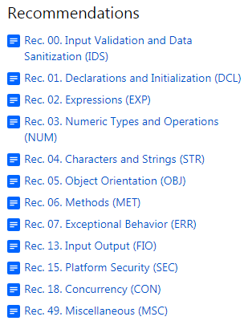
CASE STUDY – JAVA APPLICATIONS SECURITY HARDENING

Slide 4
CASE STUDY – JAVA APPLICATIONS SECURITY HARDENING
Rule 7
ERR02-J. Prevent exceptions while logging data
Exceptions that are thrown while logging is in progress can prevent successful logging unless special care is taken. Failure to account for exceptions during the logging process can

Slide 5
CASE STUDY – JAVA APPLICATIONS SECURITY HARDENING
…cause security vulnerabilities, such as allowing an attacker to conceal critical security exceptions by preventing them from being logged. Hence, programs must ensure that data logging continues to operate correctly even when exceptions are thrown

Slide 6
CASE STUDY – JAVA APPLICATIONS SECURITY HARDENING
…during the logging process.

Slide 7
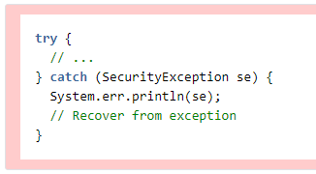
CASE STUDY – JAVA APPLICATIONS SECURITY HARDENING

Slide 8
CASE STUDY – JAVA APPLICATIONS SECURITY HARDENING
Non-compliant Code Example:
This noncompliant code example writes a critical security exception to the standard error stream:

Slide 9
CASE STUDY – JAVA APPLICATIONS SECURITY HARDENING
Writing such exceptions to the standard error stream is inadequate for logging purposes. First, the standard error stream may be exhausted or closed, preventing recording of subsequent exceptions. Second, the trust level of the standard error stream may be

Slide 10
CASE STUDY – JAVA APPLICATIONS SECURITY HARDENING
…insufficient for recording certain security-critical exceptions or errors without leaking sensitive information. If an I/O error were to occur while writing the security exception, the catch block would throw an IOException and the

Slide 11
CASE STUDY – JAVA APPLICATIONS SECURITY HARDENING
…critical security exception would be lost. Finally, an attacker may disguise the exception so that it occurs with several other innocuous exceptions.

Slide 12
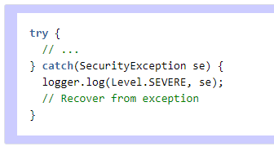
CASE STUDY – JAVA APPLICATIONS SECURITY HARDENING

Slide 13
CASE STUDY – JAVA APPLICATIONS SECURITY HARDENING
Compliant Solution:
This compliant solution uses java.util.logging.Logger, the default logging API provided by JDK 1.4 and later. Use of other compliant logging mechanisms, such as log4j, is also permitted.
Typically, only one logger is required for the entire program.
END

